Slide 1
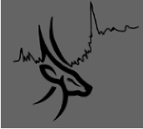
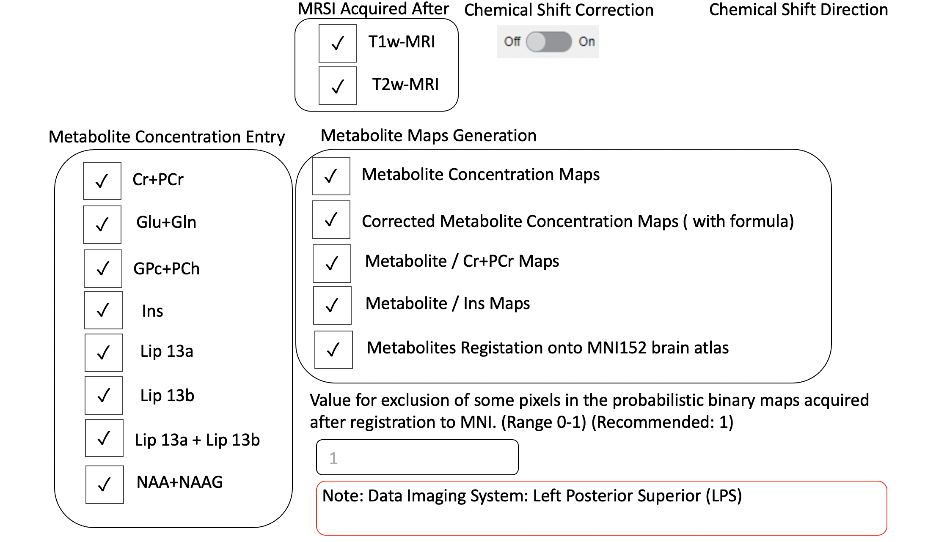
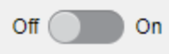








Ssss
Select a spar file under Dataset folder
GUI Page 1
~/Oryx-MRSI/Dataset/
RF Bandwidth of your system
Cut-Off Values for Exclusion Critetia
RF_ex_bw:
RF_echo_bw:
RF_echo2_bw:
Default: 4253
fcsf:
CRLB:
SNR:
FWHM:
>0.30 (Default)
Default: 1269
> 30 (Default)
Default: 1269
< 8 (Default)
> 0.10 (Default)
Note:
Gradient Ex on AP direction
Gradient Echo on RL direction
Gradient Echo2 on SI direction
>
Chemical Shift Direction AP : P
Chemical Shift Direction LR : L
Chemical Shift Direction FH : F
Note: Reference metabolite (NAA and 2.0 ppm)

Slide 2
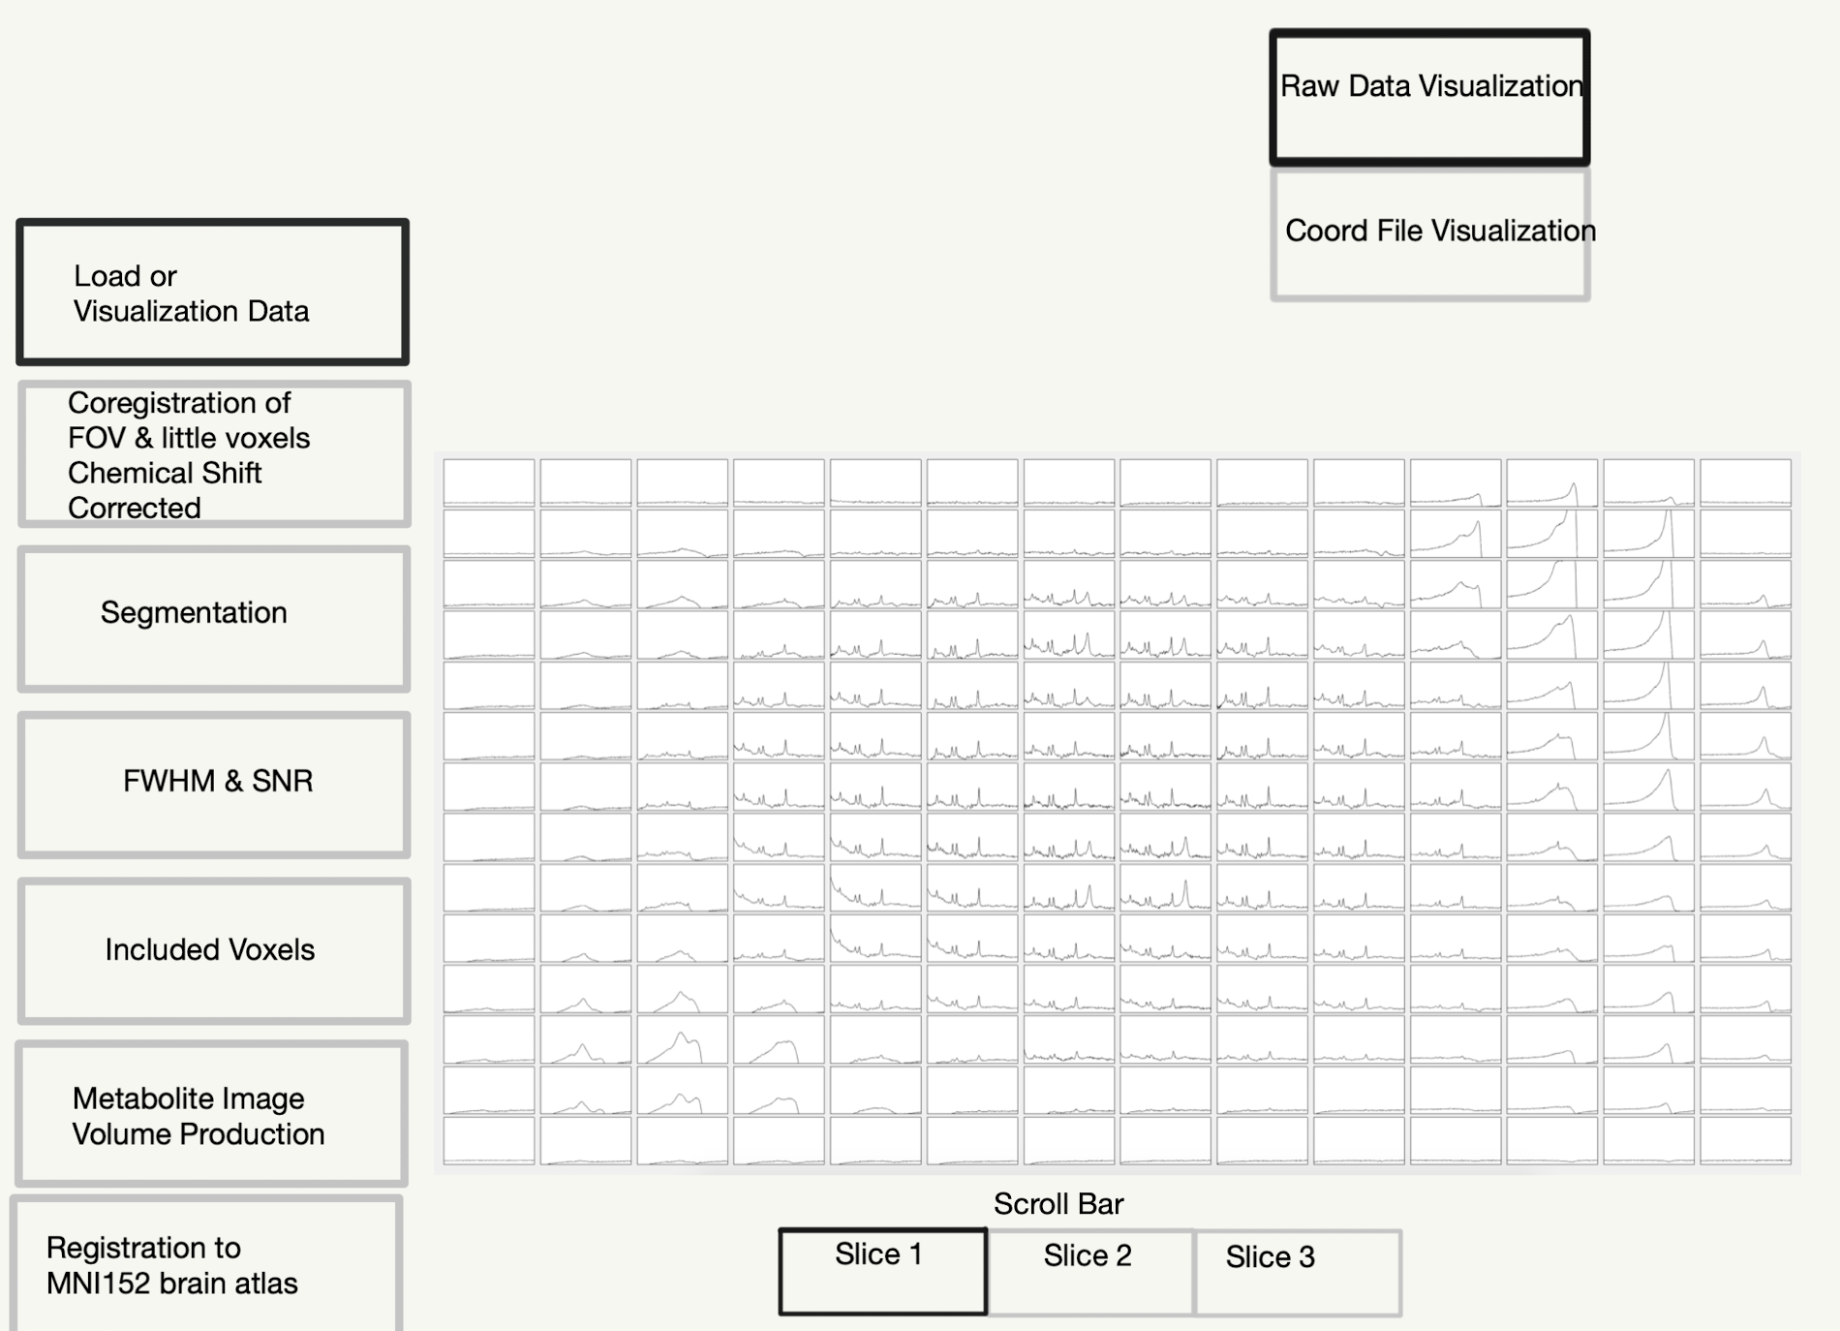
GUI Page 2

Slide 3
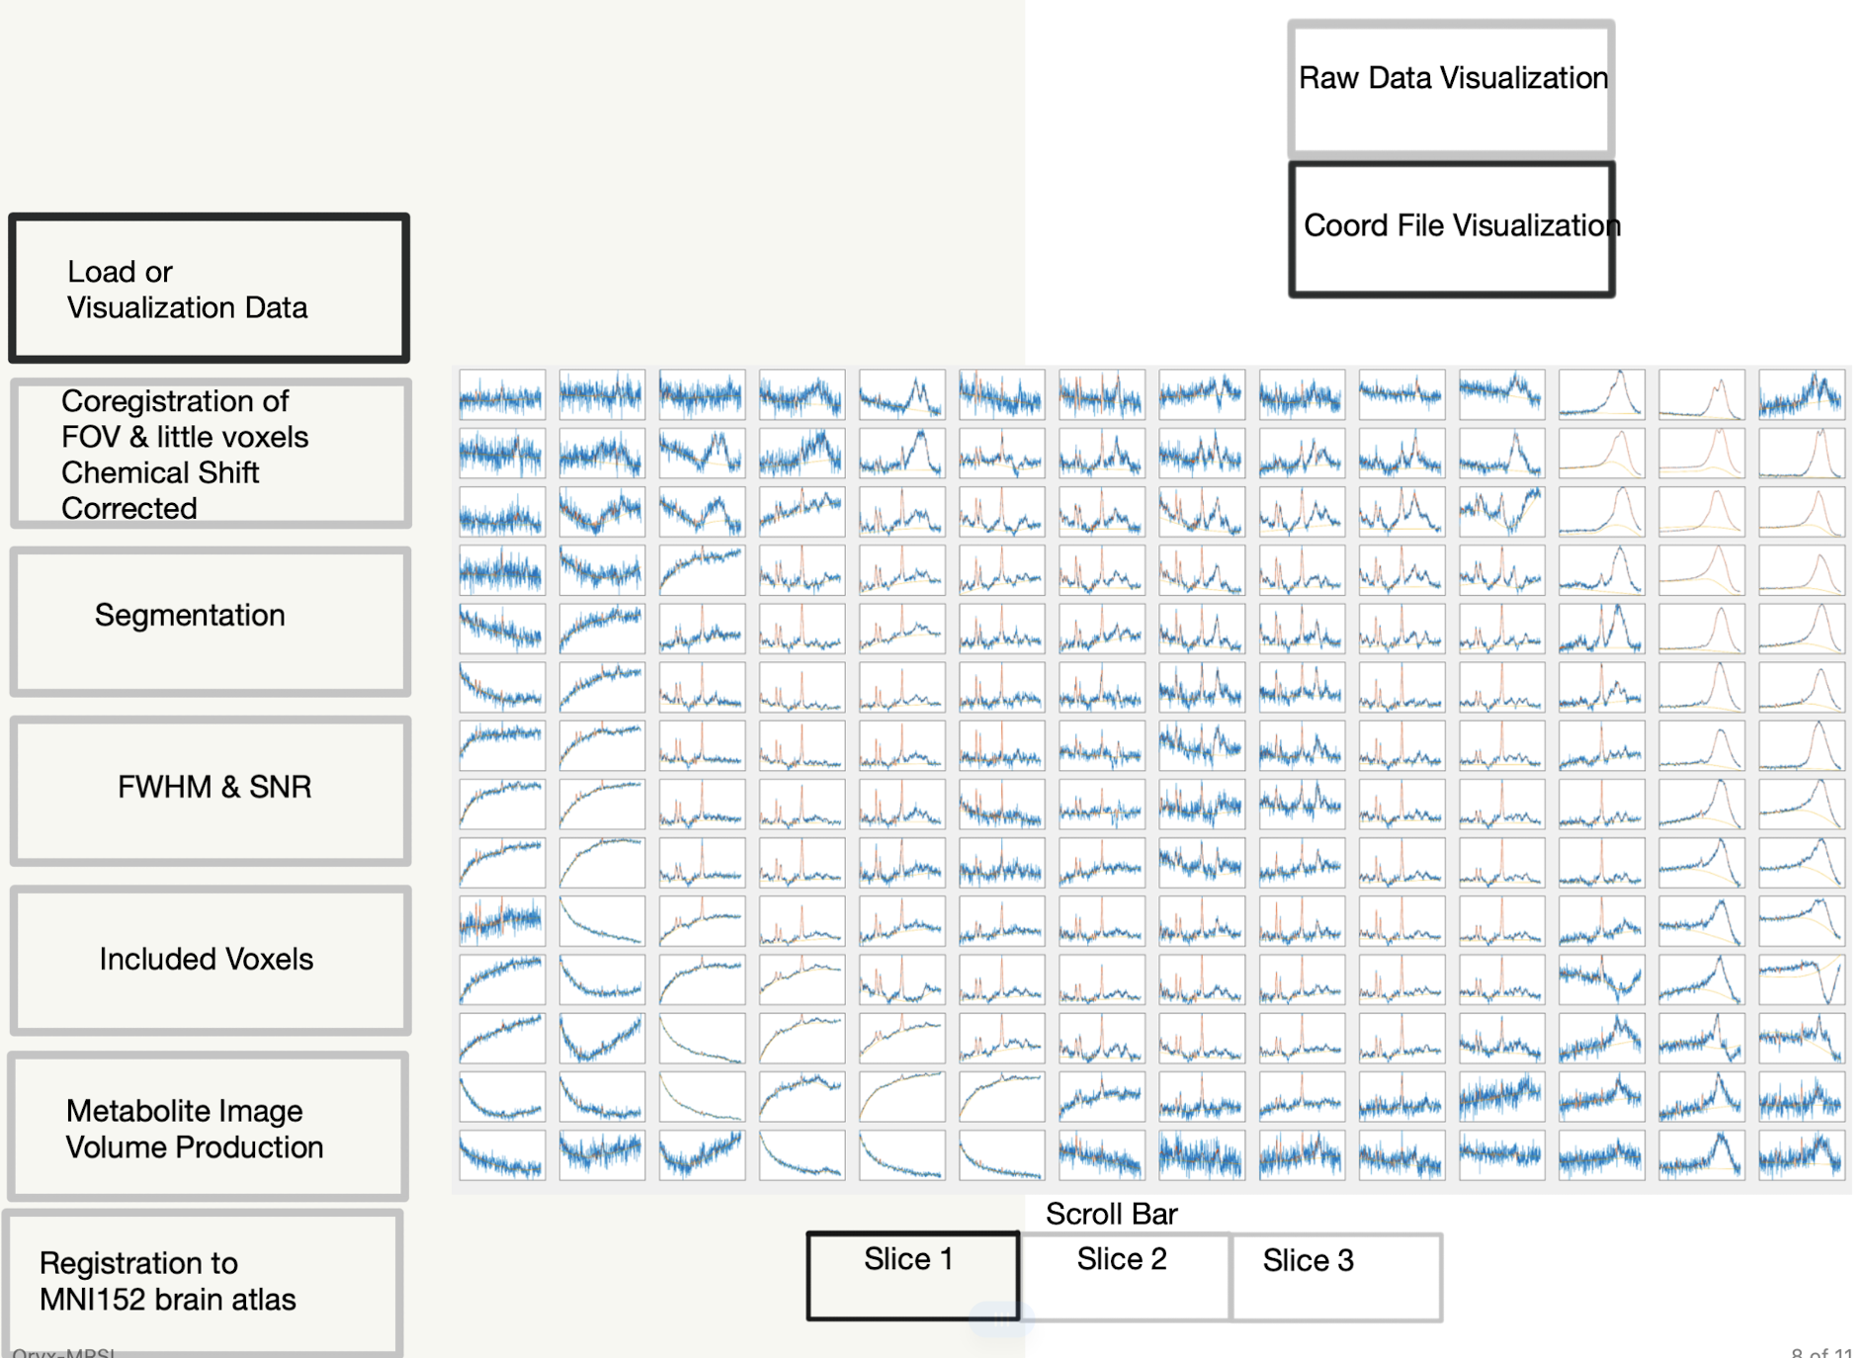
GUI Page 2

Slide 4
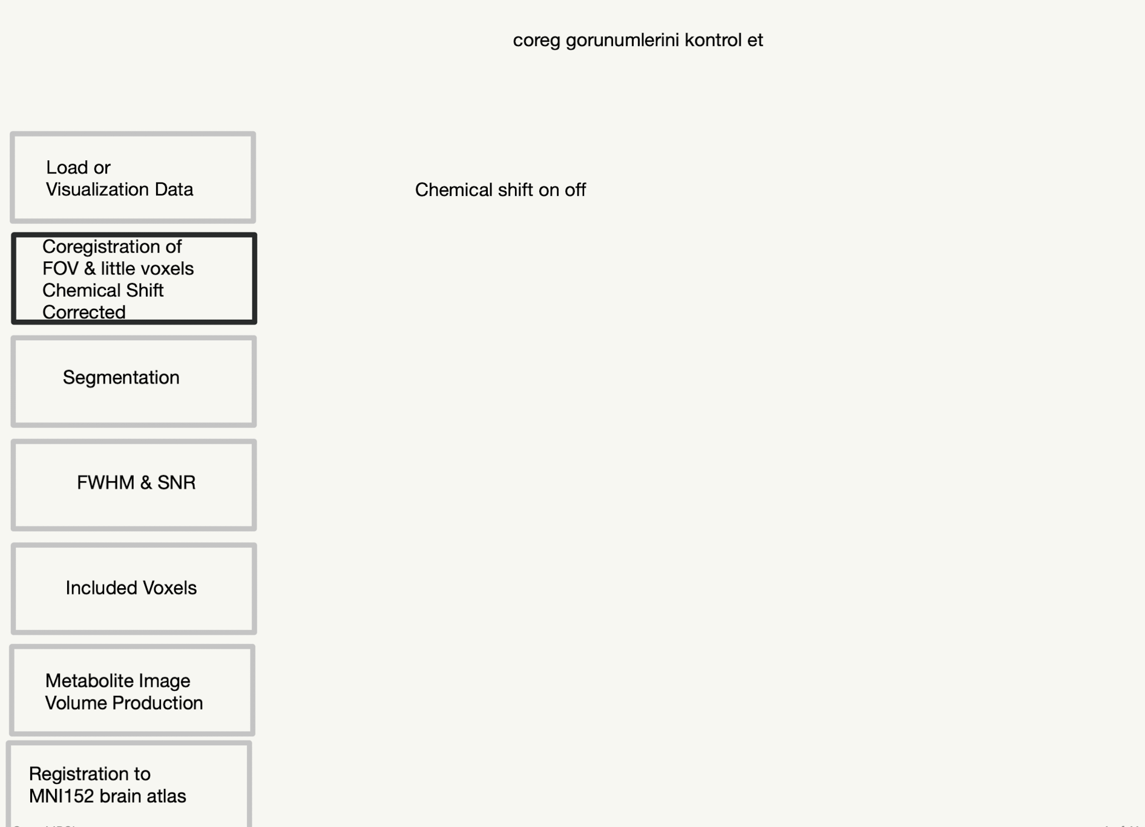
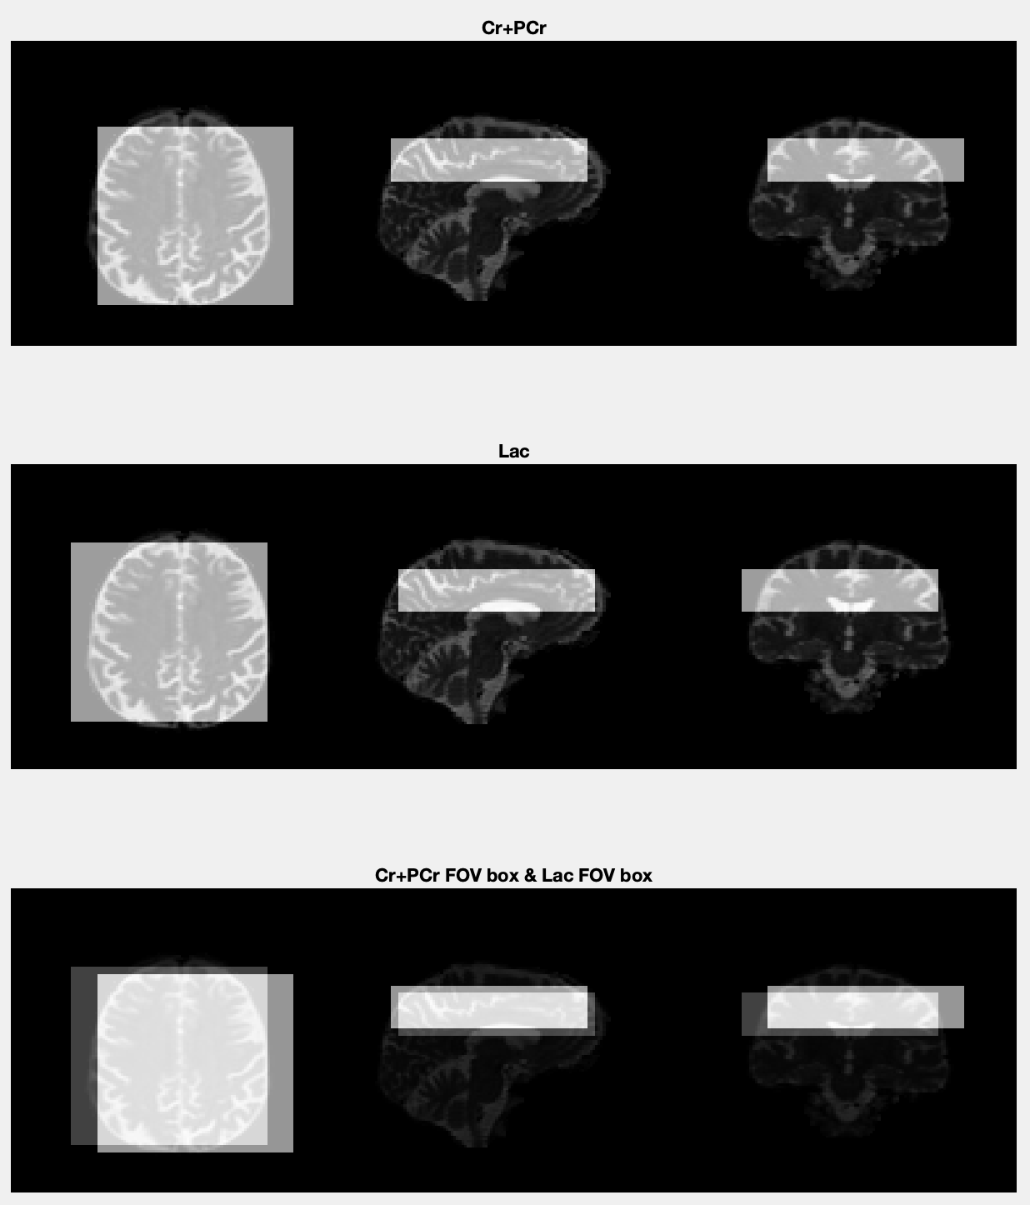
GUI Page 3

Slide 5
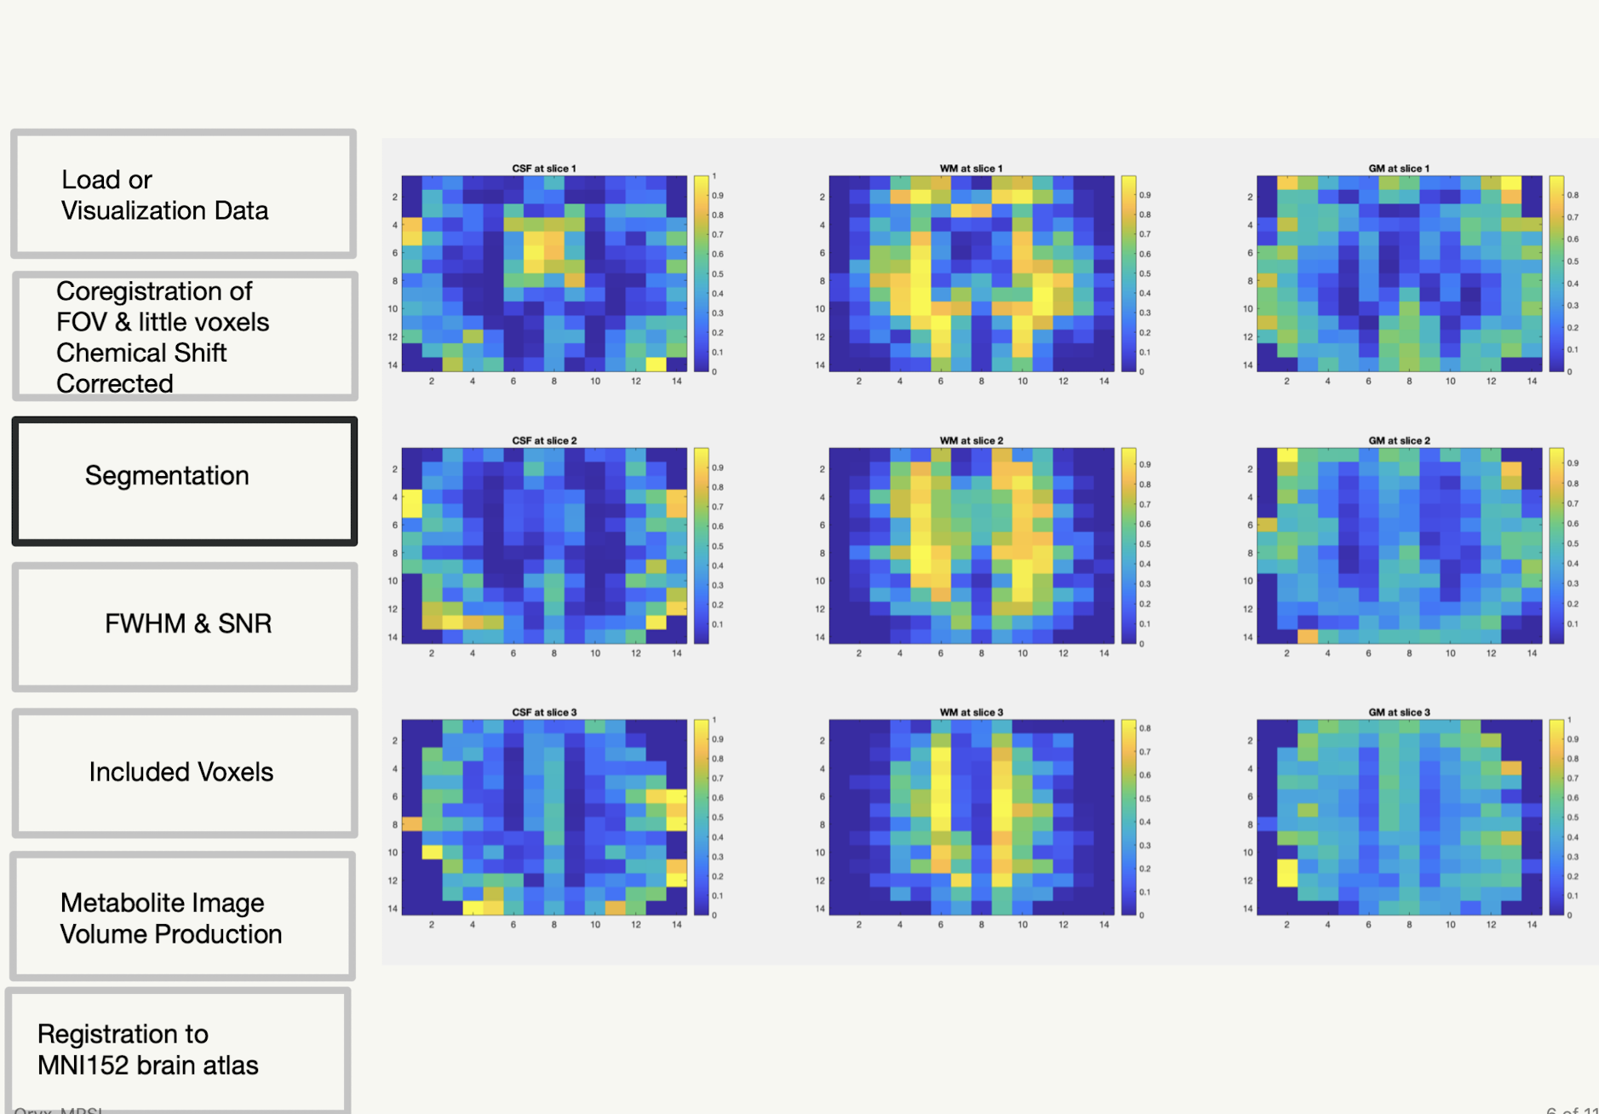
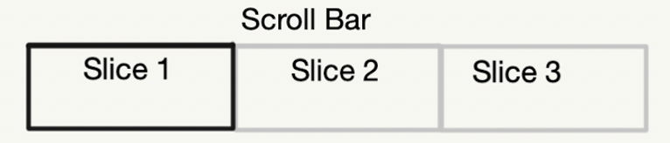
GUI Page 4
Which metabolite do you want to see?
Cr+PCr
Glu+Gln
GPC+PCh
Ins
Lac
Lip13a
Lip13b
Lip13a+Lip13b
NAA+NAAG

Slide 6
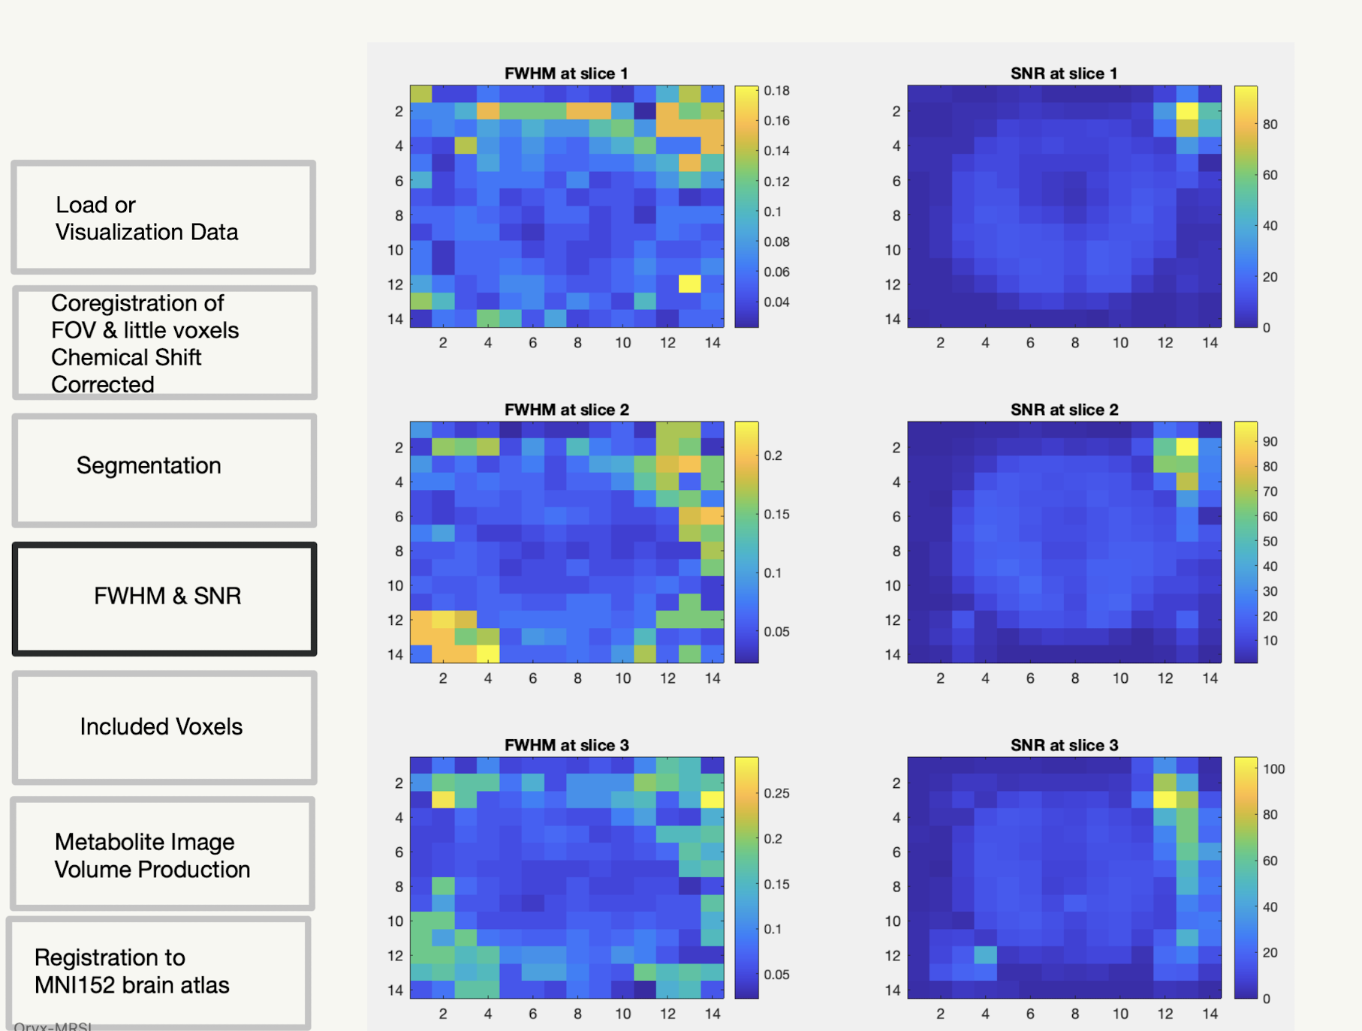
GUI Page 5

Slide 7
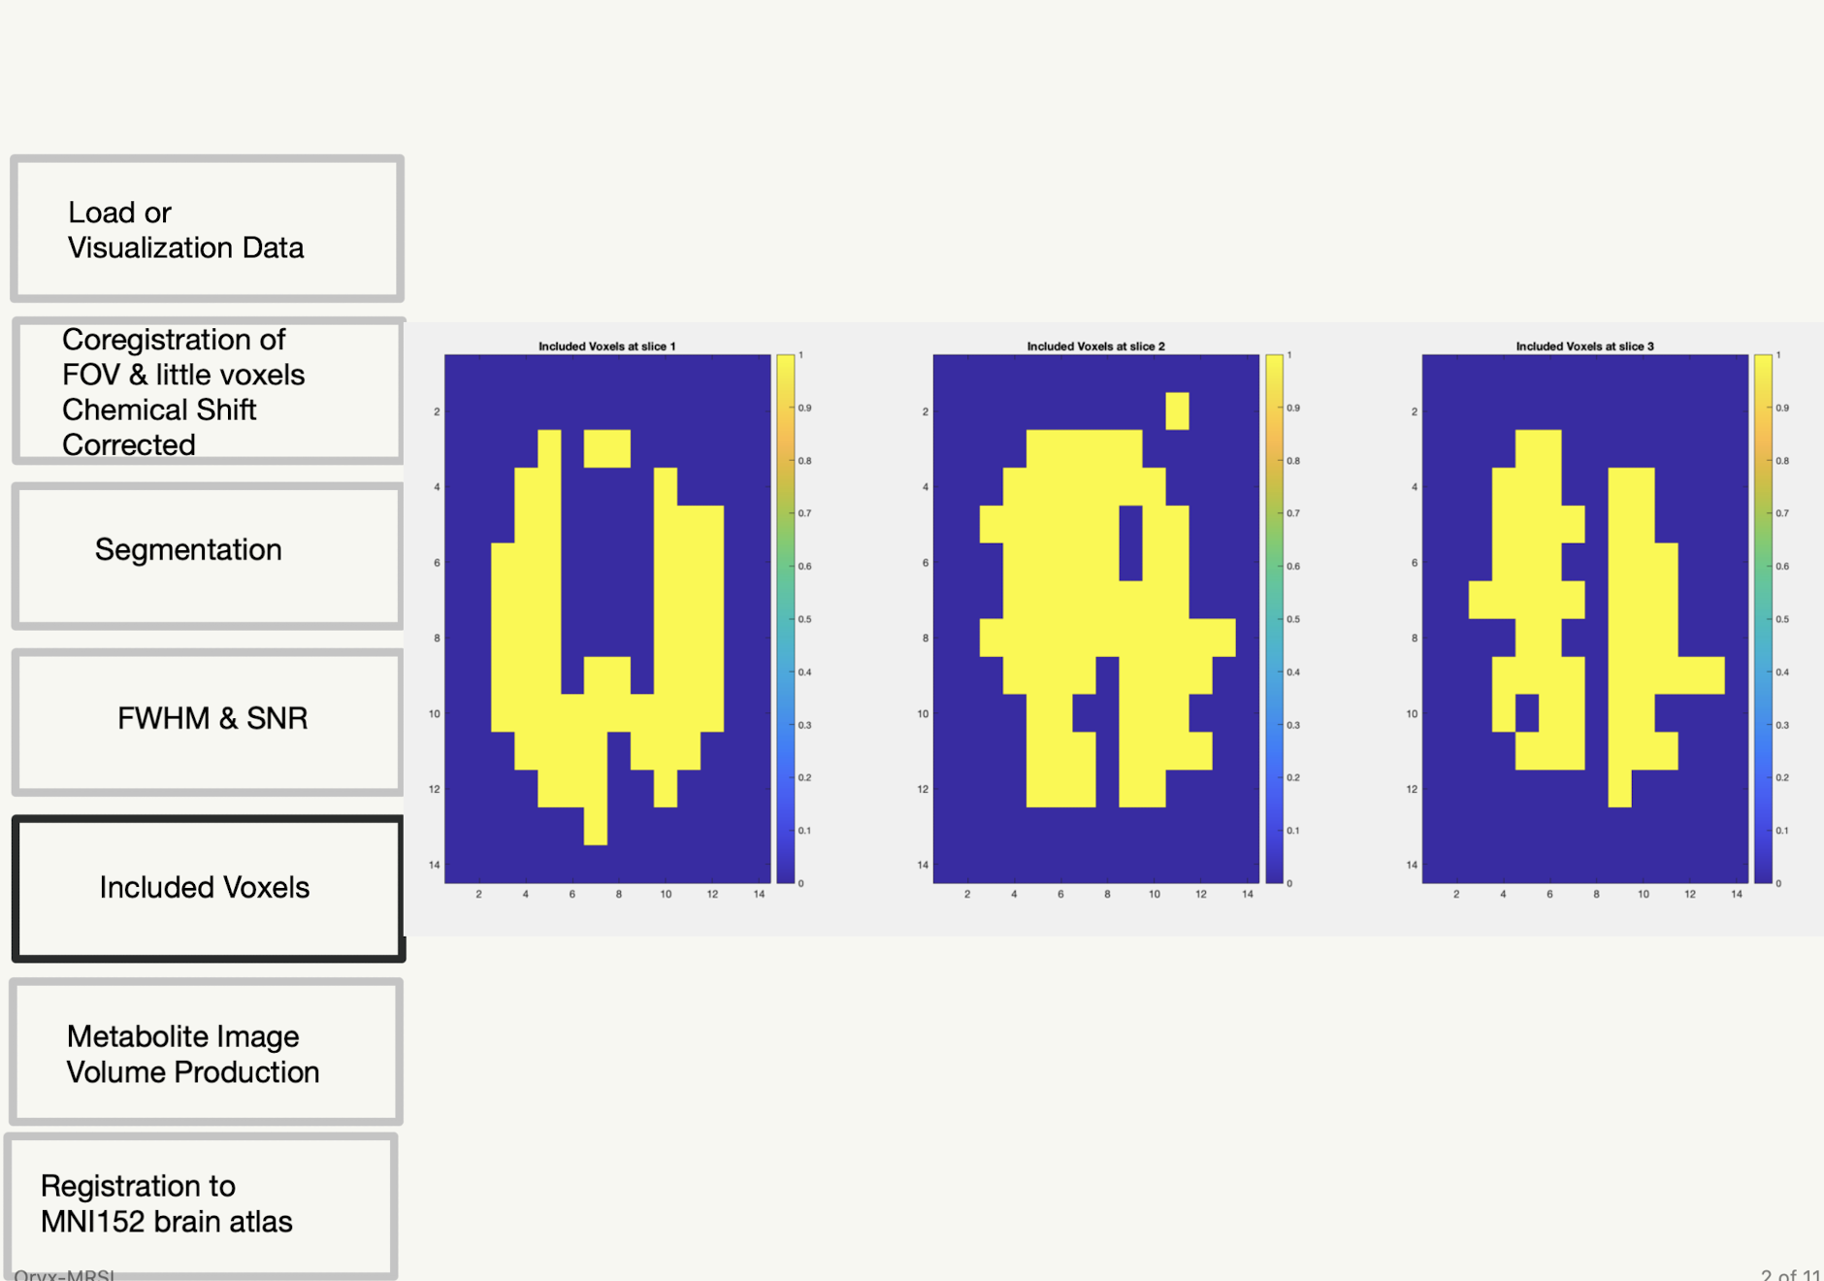
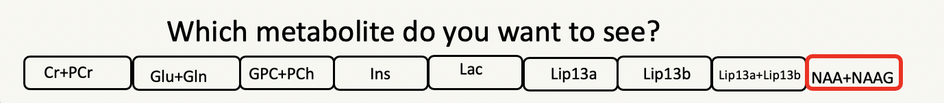
GUI Page 6

Slide 8
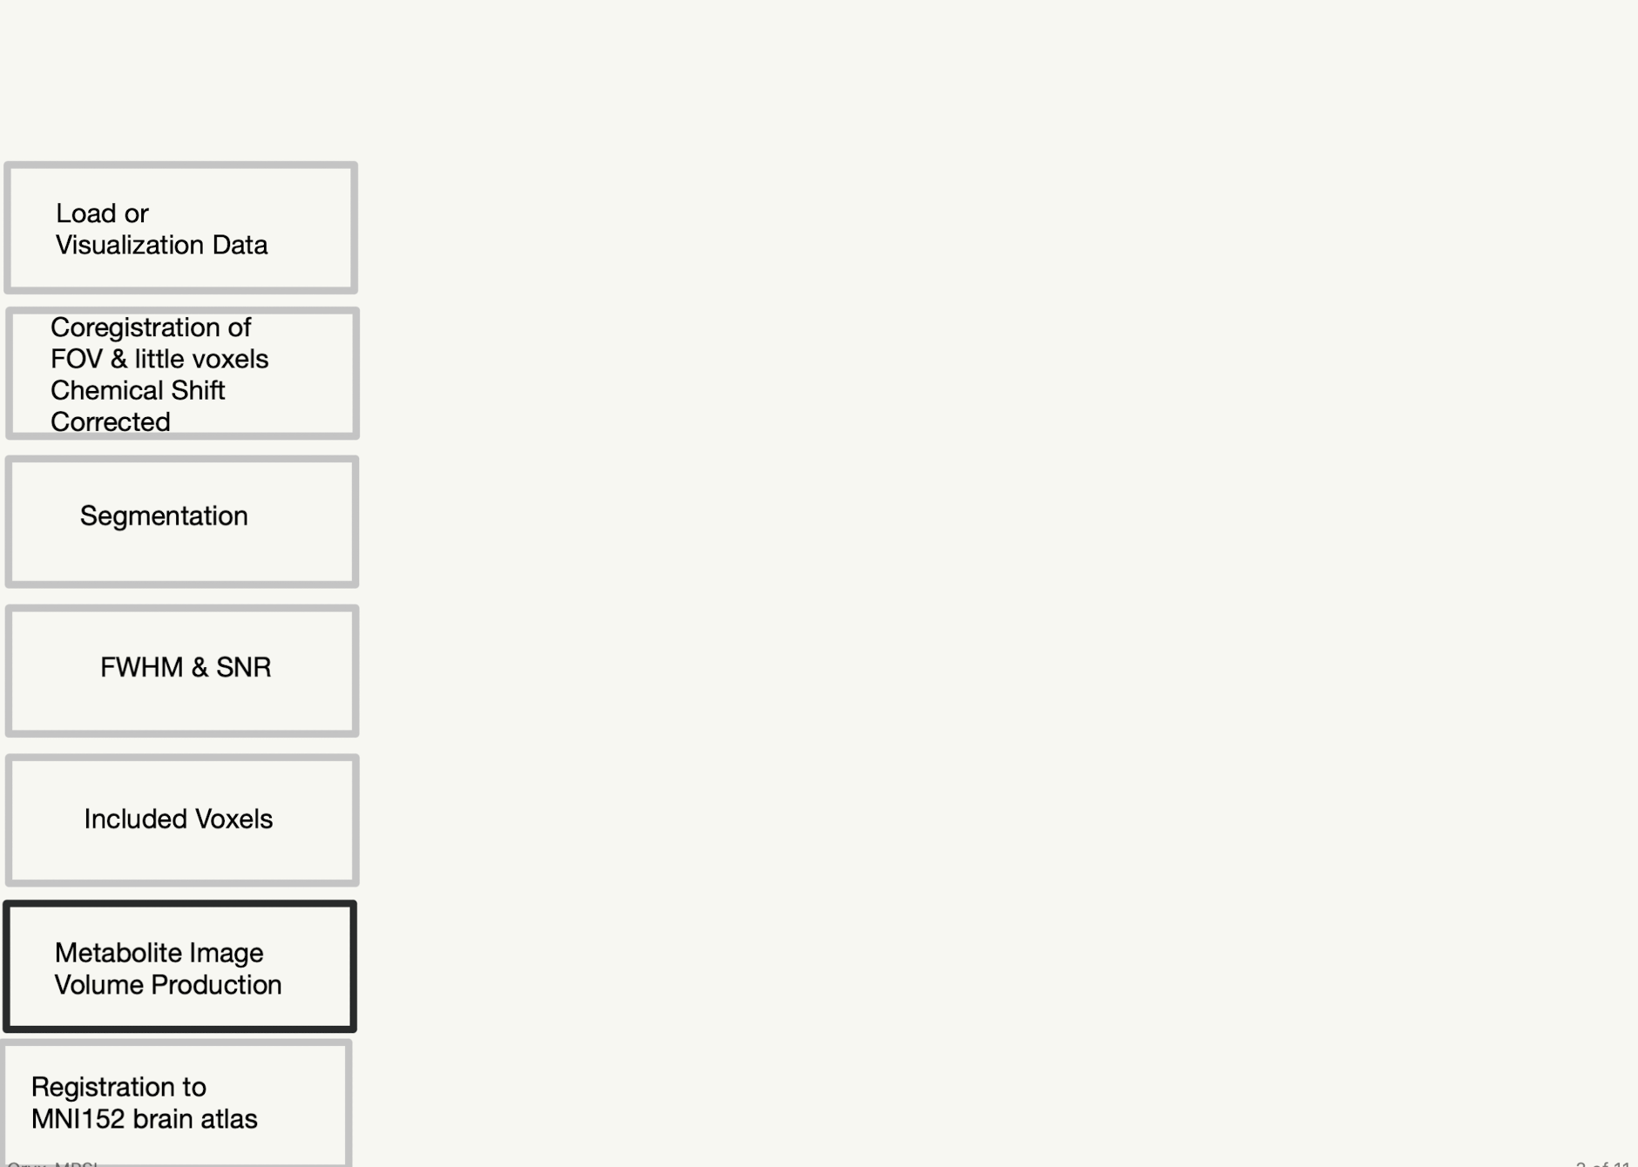
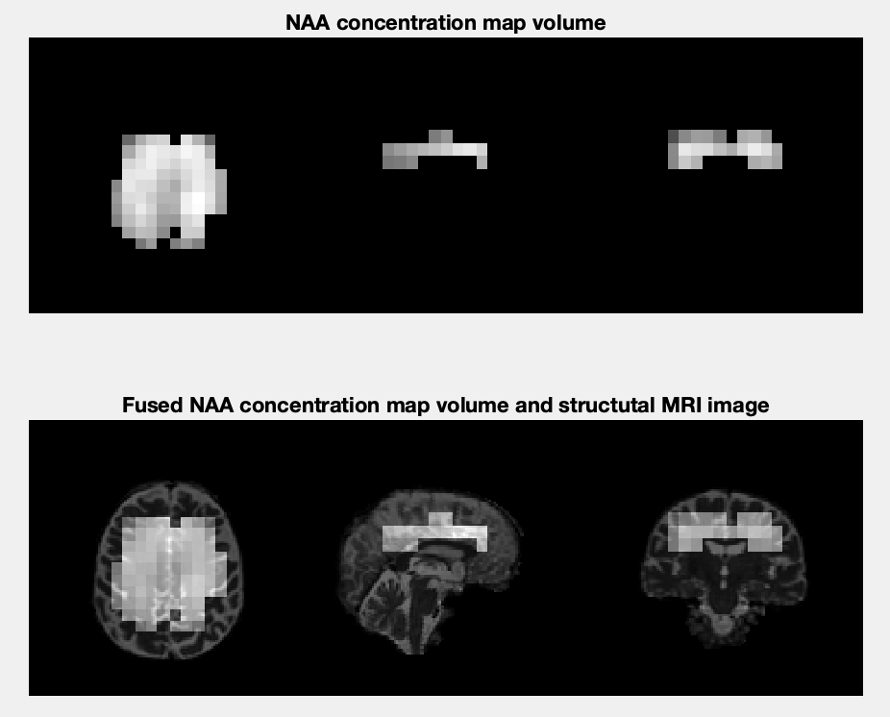
GUI Page 7

Slide 9
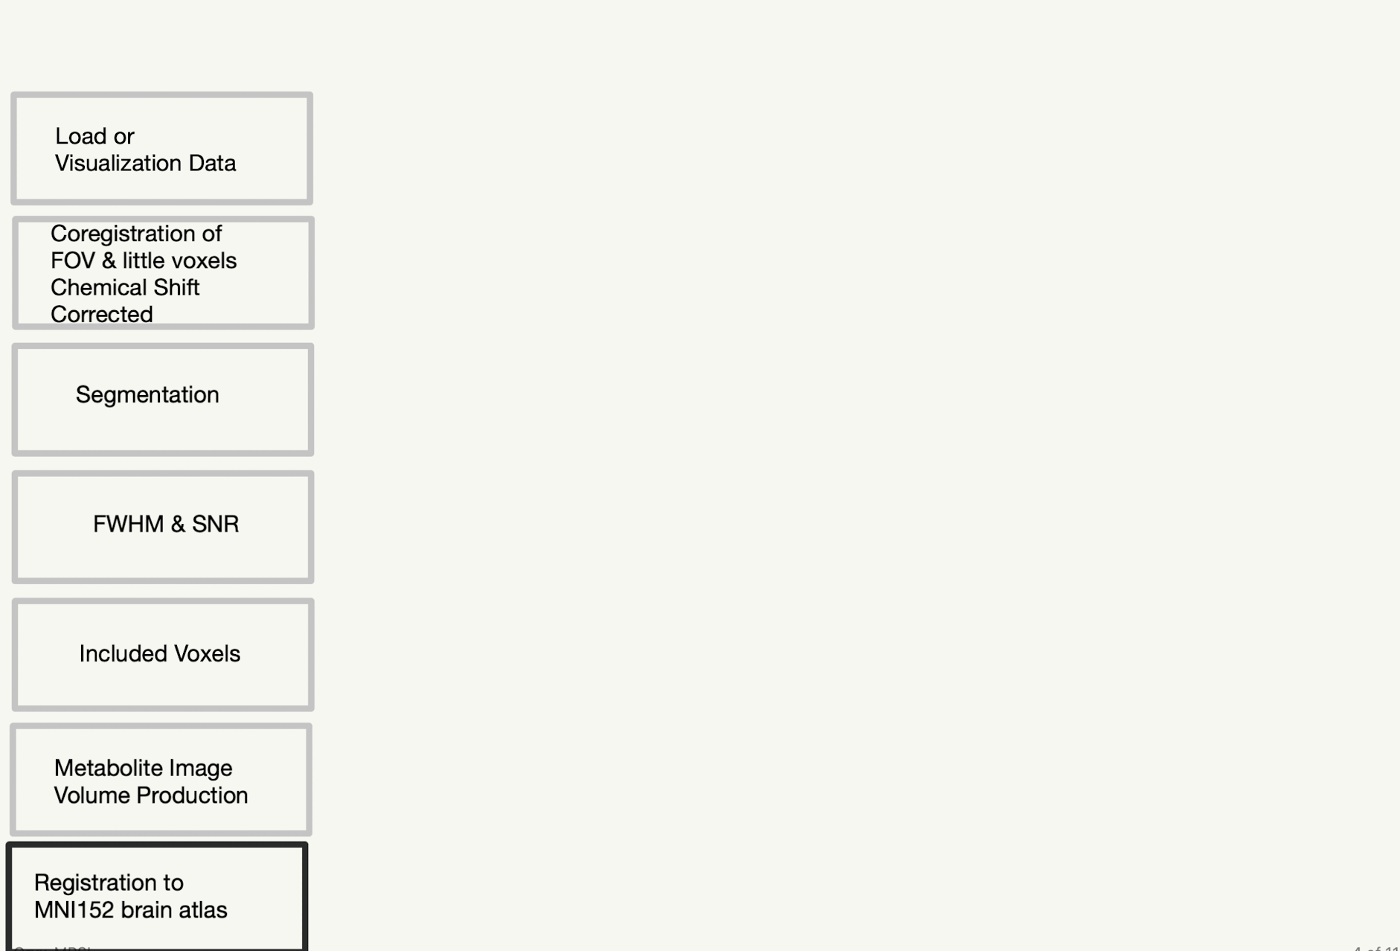
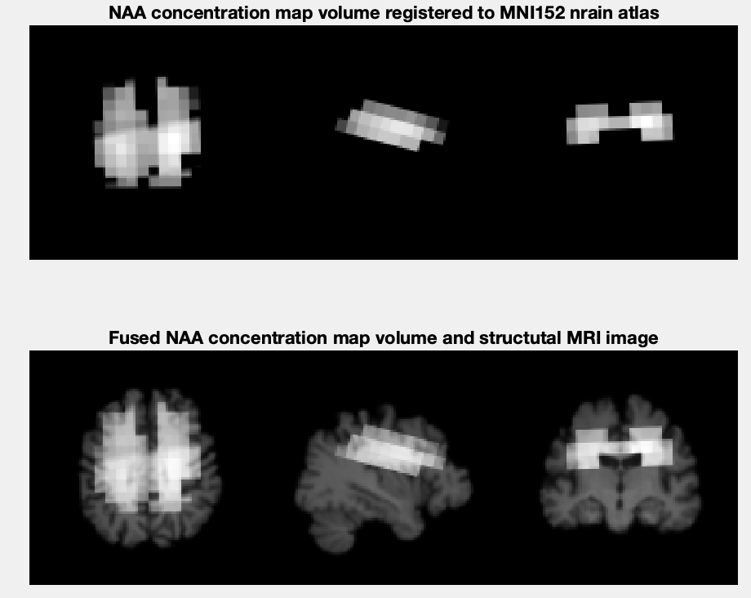
GUI Page 8

Slide 10
Analysis

